Slide 1


Machine Learning and Deep Learning: A Beginner's Guide
Discover the world of artificial intelligence through machine learning and deep learning. This guide introduces key concepts, algorithms, and techniques for beginners entering this exciting field.

Slide 2

What is Machine Learning?
1
Definition
2
Applications
Machine learning is a subset of AI that enables systems to learn from data without explicit programming.
It's used in various fields, including image recognition, natural language processing, and predictive analytics.
3
Algorithms
Machine learning utilizes algorithms like decision trees, support vector machines, and neural networks.

Slide 3

Deep Learning :
The Next Frontier
1
Definition
Deep learning is a subset of machine learning using multi-layered neural networks.
2
Advancements
It has revolutionized AI with breakthroughs in image and speech recognition.
3
Applications
Deep learning powers autonomous vehicles, virtual assistants, and advanced medical diagnostics.

Slide 4
Fundamental Concepts in Machine Learning
Binary Classification
Features
K-Nearest Neighbors
Task of categorizing data into two classes. Uses algorithms like logistic regression and SVMs.
Input variables used for prediction. Feature selection and engineering are crucial for model performance.
Simple yet effective algorithm for classification and regression based on proximity to neighbors.

Slide 5
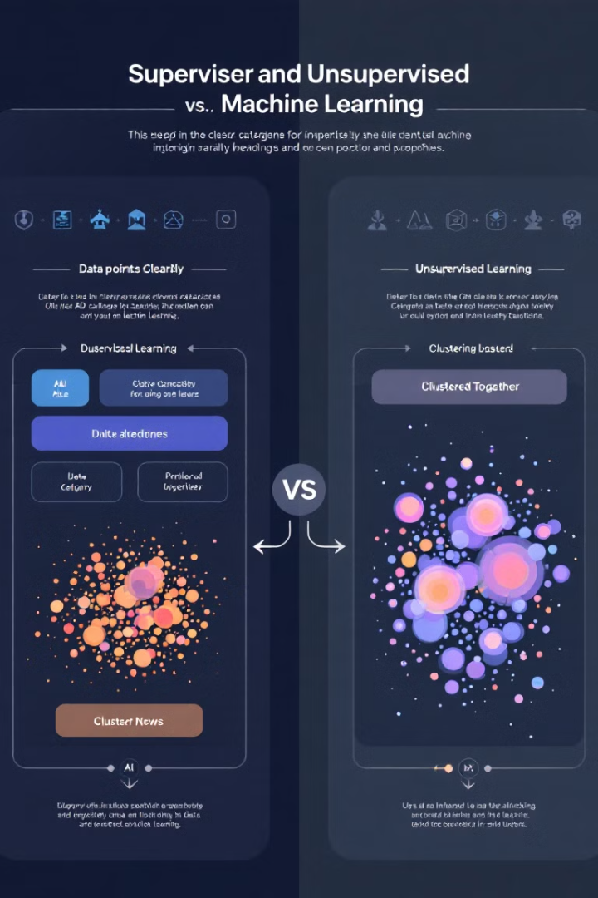
Types of Machine Learning
Supervised Learning
Unsupervised Learning
Models learn from labeled data. Used for classification and regression tasks.
Discovers patterns in unlabeled data. Includes clustering and dimensionality reduction techniques.
Sampling Bias
Data Preprocessing
Occurs when training data doesn't represent the population. Can lead to inaccurate models.
Crucial step involving cleaning, normalization, and feature engineering to improve model performance.

Slide 6




Regression Techniques
Linear Regression
Models linear relationship between variables. Simple but effective for many problems.
Polynomial Regression
Extends linear regression to capture non-linear relationships using polynomial functions.
Ridge and Lasso Regression
Regularization techniques to prevent overfitting in high-dimensional data.

Slide 7

Classification Techniques
Technique
Key Feature
Use Case
Logistic Regression
Sigmoid Function
Binary Classification
Softmax Regression
Softmax Function
Multi-class Classification
Support Vector Machines
Hinge Loss
Binary and Multi-class Classification

Slide 8




Optimization Techniques
Stochastic Gradient Descent
Updates model parameters using one training example at a time. Fast but noisy.
Mini-batch Gradient Descent
Balances speed and stability by using small batches of training data.
Batch Gradient Descent
Uses entire dataset for each update. Stable but computationally expensive for large datasets.

